Slide 1
Python for Data Science
By Bhumireddy Harivardhan REDDY

Slide 2
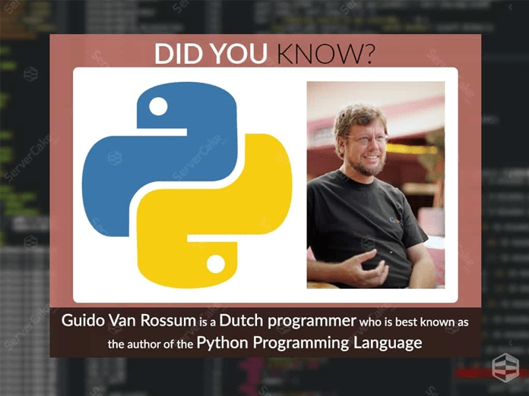
PYTHON INTRODUCTION
What is python?
Python is a popular programming language.
Python was created by Guido Van Rossum.
It is a object oriented programming language.
Python is an interpreted, high-level and general-purpose programming
language.
Python is a dynamically typed language.
It was released by February 1991.
It was released by February 1991.
Python is used for the following purposes,
Python is used for web development.
Softwere development
Machine Learning
Data Science

Slide 3
PYTHON FOR DATA SCIENCE
What can Python do?
Python can be used on a server to create web applications.
Python can be used alongside software to create workflows.
Python can connect to database systems. It can also read and modify files.
Python can be used to handle big data and perform complex mathematics.

Slide 4
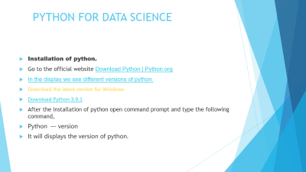
PYTHON FOR DATA SCIENCE
Why Python?
Python works on different platforms (Windows, Mac, Linux, Raspberry Pi, etc).
Python has a simple syntax similar to the English language.
Python has syntax that allows developers to write programs with fewer lines than some other programming languages.
Python runs on an interpreter system, meaning that code can be executed as soon as it is written.

Slide 5
PYTHON FOR DATA SCIENCE
Installation of python.
Go to the official website Download Python | Python.org
In the display we see different versions of python.
Download the latest version for Windows
Download Python 3.9.1
After the installation of python open command prompt and type the following command,
Python –- version
It will displays the version of python.

Slide 6
PYTHON FOR DATA SCIENCE
Setup and installation
Anakonda is a distribution of python.
Not only for python but many libraries that we use in course.
It is an “all in one” that is extremely used in Data science and Machine Learning.
Jupyter is a development environment where we can write code, display images, and write mark down notes.
Jupyter is the most popular IDE(Integrated development Environment) in data science.
It also a great learning tool.

Slide 7
PYTHON FOR DATA SCIENCE
Note for experienced users:
Feel free to use any ide you prefer!
We are not forcing to use jupyter as IDE!
The python code works in any environment.

Slide 8
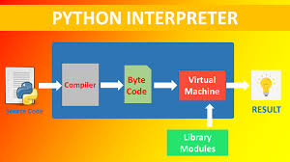
PYTHON FOR DATA SCIENCE
Python Interpreter
An interpreter is a kind of programme that executes other programmes when you write python programmes, it converts source code written by the developer in to intermediate language, again it converts into native language or machine language.
The python code written by the developer or by you is computed is byte code, which creates extension with .py
Source code

Slide 9
PYTHON FOR DATA SCIENCE
Why python?
Easy to learn
Easy syntax.
Data science
Machine learning
Artificial intelligence
Image processing
Rich in libraries.

Slide 10
PYTHON FOR DATA SCIENCE
Versions of python
The first version of python was released in February 1991.
The current version of python is 3.8.1
The latest version of python is 3.9
How to check the version of python.?
Open command prompt
Type python –version
Hit enter.

Slide 11
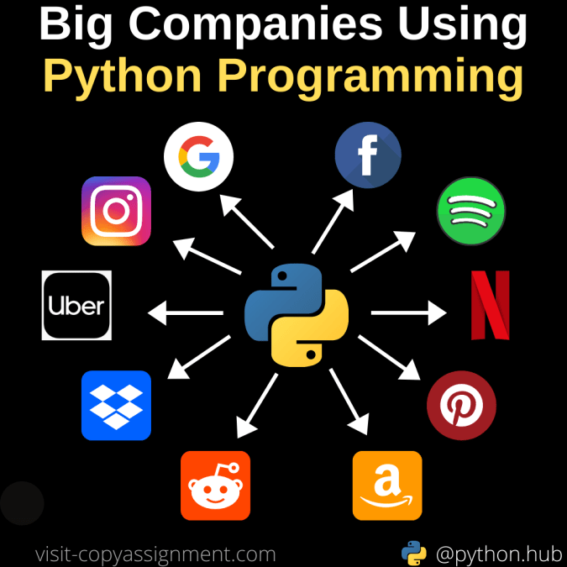
PYTHON FOR DATA SCIENCE
TOP COMPANIES USING PYTHON
INSTAGRAM
GOOGLE
DROPBOX
YOUTUBE
UBER
NETFLIX etc

Slide 12
PYTHON FOR DATA SCIENCE
PYTHON IDLE
Python IDLE is one of the IDEs used for Python programming. It automatically gets downloaded when we install Anaconda. IDLE stands for Integrated Development and Learning Environment.
You can access it by opening the command prompt and typing IDLE. It will give the IDLE as the result after opening it a Python shell is opened where you can begin coding. Shell is an interactive interpreter. It provides the output for each line of code immediately. Pressing the enter key not only changes the line but produces the immediate result of the line after which it is pressed. Unlike Jupyter Notebook, IDLE doesn’t allow us to write the complete code first and then compute the results. But if a user wants to check each line of his code as he types it, he will prefer Python IDLE over Jupyter Notebook.

Slide 13
PYTHON FOR DATA SCIENCE
Jupyter Notebook is basically a web application. Unlike IDEs (Integrated Development Environment), it uses the internet to run. And even after not being able to perform offline, it is highly preferred by most of the beginners because of its rich formatting and user-friendly interface. It allows us to enter the code in the browser and automatically highlights the syntax. It helps us know if we are indenting the code correctly with the help of colors and bold formatting. For example, if we write the print command outside the scope of a loop, it will change the color of the print keyword. Whitespace plays a very important role in Python because Python doesn’t involve the use of braces for enclosing the bodies of loops, methods, etc. A single indentation mistake can lead to an error. The results are displayed in different representations like HTML, PNG, LaTeX, SVG, PDF, etc.

Slide 14
PYTHON FOR DATA SCIENCE
Comments in python
Comments in python are used to explain the code and make the code more readable.
There are two types of Comments are there:
They are
1)Single line comments
2)Multi line comments

Slide 15
PYTHON FOR DATA SCIENCE
1)Single line comments
Single line comments are indicated by #.
These comment is used in any where in the programme.
For example,
#this is single line comments
Print(“we are learning single line comments in python”)

Slide 16
PYTHON FOR DATA SCIENCE
2)Multi line comments
Multi line comments are indicated by thrible coats
Print(“example of multiline comments”)
“””this is multiline comments”””

Slide 17
PYTHON FOR DATA SCIENCE
What is variable?
In any programming language variables are like storage tanks or containers for storing data.
You can declare a variable by simply typing its name.
###And there is no need to assign the type of variable.
As python automatically does it for you.
For example
a = 13
Z=“welcome to python world”
Print(a)
Print(z)

Slide 18
PYTHON FOR DATA SCCIENCE
Rules for naming a variable?
There are some rules in python for naming a variable, some of them are:
A variable must start with a letter or underscore character.
A variable cannot start with a number.
A variable name can contain only alpha numeric characters and underscores.
Variables names are case sensitive(age Age AGE are the three different types of variables.)

Slide 19
PYTHON FOR DATA SCIENCE
Multiple variables assign in one line……………
You can assign values to any number of variable in a single line, see the example below
a,b,c,d = 1,2,3,4,”sekhar”
Print(a)
Print(b)
Print(c)
Print(d)

Slide 20
PYTHON FOR DATA SCIENCE
Assigning one value to the different variables……
a=b=c = “Hello world”
print(a)
print(b)
print(c)

Slide 21
PYTHON FOR DATA SCIENCE
Python Data types
Variables are used to store data.
The data is related to some specific type like string, integer or any sequence in any programming language.
Python data types is similar to other programming language.
Python also has predefined data types.

Slide 22
PYTHON FOR DATA SCIENCE
Data type Categories
Text string
Numeric integer, flot, complex
Sequence list, tuple
Mapping Dictonary
Set set, frozen
Boolean Boolean
Binary bytes, byte array, memoryview

Slide 23
PYTHON FOR DATA SCIENCE
type() in python
In python type() function is used to determine the type of data types.
For example
a=32
Print(a)
Print(type(a))
OUT PUT:
32
Class<int>

Slide 24
PYTHON FOR DATA SCIENCE
Type casting or type conversion:
Type casting or type conversion is the conversion of variable from on data type to another data type.
For example, integer to flotting and flotting to integer
Example:
Var1=12.3
Var2=int(var1)
Var3=complex(var1)
Var4=str(var1)

Slide 25
PYTHON FOR DATA SCIENCE
Print(var1)
Print(var2)
Print(var3)
Print(var4)
OUTPUT:
12.3
12
12+3j
12.3

Slide 26
PYTHON FOR DATA SCIENCE
Python numeric data types:
There are three types of numeric data types are there, they are;
1)integer
2)flotting point
3)complex

Slide 27
PYTHON FOR DATA SCIENCE
Integer:
An integer is a whole number(positive number, negative number, or zero).
The length of an integer is unlimited.
For example
C=454959556555562565
X=0
Print(c)
Print(x)
Print(type(c))
Print(type(x))
OUTPUT:
454959556555562565
0
Class<int>
Class<int>

Slide 28
PYTHON FOR DATA SCIENCE
Floatting point number
A floattig point number is a decimal number or similar to decimal numbers.
For example
1)W=200.2
Print(w)
Print(type(w))
2)d=-15.5
Print(d)
Print(type(d))
X=0
Print(x)
Print(type(x))

Slide 29
PYTHON FOR DATA SCIENCE
Complex number:
In python complex numbers are created by using “j” after the number.
For example
D=3+4j
E=-8-5j
Print(D)
Print(type(D))
Print(E)
Print(type(E)

Slide 30
PYTHON FOR DATA SCIENCE
Python Strings……
What is string in python?
Any thing inside single(‘’) or double(“”) quots is considered as a string.
Assigning string to a variable…
a = "hello world“
b=‘python’
Print(a)
Print(b)
Print(type(a))
Print(type(b))

Slide 31
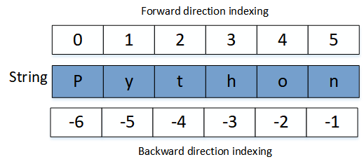
PYTHON FOR DATA SCIENCE
Indexing in string….
There are two types of indexing
1)positive indexing
2)negative indexing
Python provides both types of indexing ie both positive and negative indexing.
Positive indexing starts from left end with 0 and negative indexing starts from right end with -1.

Slide 32
PYTHON FOR DATA SCIENCE
String Slicing.
String slicing means to choose or return some characters from the string. In python, anything inside single or double quotes is considered to be a string and the spaces are also counted during indexing of a string.
For example,
my_str=“I am a string”
Print(len(my_str))
Print(lmy_str[0])
Print(my_str[-1])
Note:in string slicing after: is subtracted by 1

Slide 33
PYTHON FOR DATA SCIENCE
String concatation
In python concatation meance to add.
We use “+” symbol to add.
For example
here,
A = “hello”
B = “world”
C = A+B
Print(C)

Slide 34
PYTHON FOR DATA SCIENCE
Comma in print statement:
We use comma(,) inside print statement with many objects like strings, list, tuples.
This comma creates a space between two objects.
Lets see some example
print(“my name is”, “sekharreddy”)
This function also used to separate two strings and numbers.

Slide 35
PYTHON FOR DATA SCIENCE
Format method:
we use format method after string is to insert some specified values inside strings.
We use {}to insert specified values.
Example:
Print(“name:{name} and age:{age}”.format(name = “sekhar”,age = 24))
print("my name is {name} and age is:{age}".format(name = "sekhar",age = 24))

Slide 36
PYTHON FOR DATA SCIENCE
Lower case()
In python lower case() method will return the string of all letters to lower case.(big letters to small letters)
S = “PYTHON”
Print(S.lower())
Upper case()
In python upper case() method will return the string of all letters to upper case.(small letters to big letters)
A = “pythoh”
print(A,upper())
python
PYTHON

Slide 37
PYTHON FOR DATA SCIENCE
Replace method:
This method is used to replace a string or letters to other.
For example
A = “this is a string”
A.replace(“this”, “that”)
Print(A)

Slide 38
PYTHON FOR DATA SCIENCE
Python List:
Python list are sequential data type.
It meance to allow to store different types values.
Python list are indicated or enclosed with([])square brackets.
And the elements are enclosed with comma(,).
Lists are mutable in nature ie we change the any elements of value of list as we want.

Slide 39
PYTHON FOR DATA SCIENCE
Some ecamples
myList = [1, 2, 3, 4, "Hello", "World"]
print(myList)
print(myList[0])
print(myList[1])
print(myList[5])
print(myList[-1])
print(myList[-2])

Slide 40
PYTHON FOR DATA SCIENCE
List Slicing:
List slicing very easy, just type the range of indexes to get the elements inside that range.
For example,
myList = [1, 2, 3, 4, "Hello", "World"]
print(myList)
print(myList[0:5])
print(myList[0:6])
print(myList[1:4])
print(myList[-4:-1])
print(myList[-3:-2])
print(myList[:6])
print(myList[0:])

Slide 41
PYTHON FOR DATA SCIENCE
Changing list value:
To change the element of the list, just type type the list name with the index in square brackets([]).
For example
List1 = [1,2,3,4]
Print(List1)
List1[0]=5

